Slide 1
Kaartkleuren
Elias Gorter
Kirtsen de Wit
Sangeeta van Beemen

Slide 2
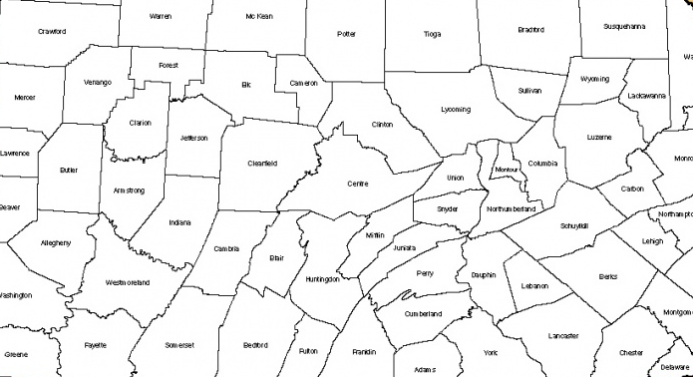
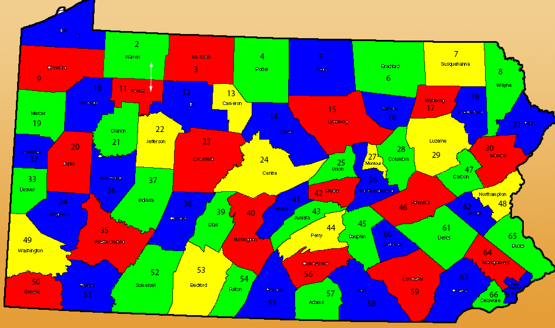
De Case

Slide 3
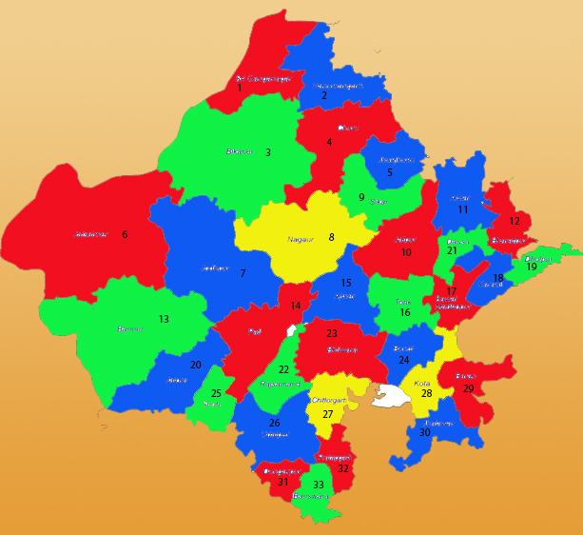
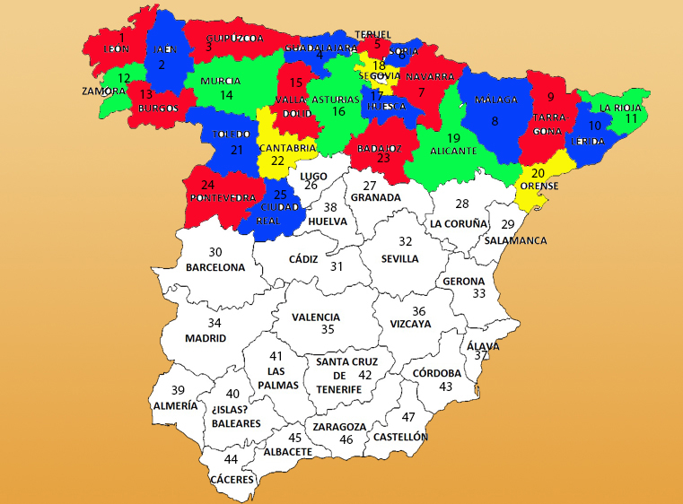
Rijen
Oplossing
Probleem

Slide 4
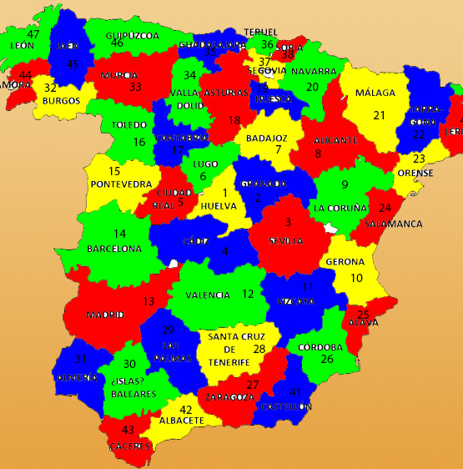
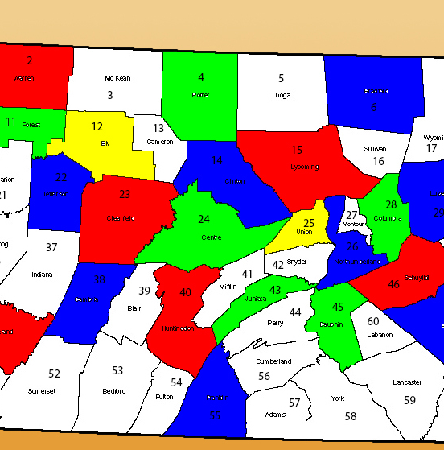
Meeste Verbindingen
Oplossing
Probleem

Slide 5
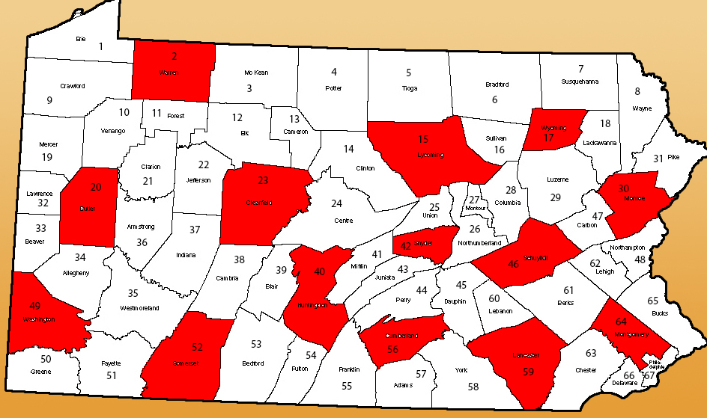
Dominating Set

Slide 6
Backtracking

Slide 7
Combinatie van Methodes
Dominating Set
Meeste Verbindingen
Backtracking

Slide 8
for each country in dominating_set_list add country to colour_list sort buurlanden add sorted buurlanden to colour_list possible is true for each country in colour_list calculate possible colours add possible colours to temp_list if possible is false remove up till and including self.kleur from temp_list if temp_list is not empty assign first colour in temp_list to self.kleur set possible to true else set possible to false go back to previous country in colour_list

Slide 9
Theorie Minimum Kleuren

Slide 10
De Harmony Theorie

Slide 11
Conclusie

